Slide 1
Assembly Function recognition (AFR) in embedded systems independent architecture
Mr. Matan Avitan
matanavtian100@gmail.com
Prof. Zeev (Vladimir) Volkovich
November 2019

Slide 2
</Abstract>
Function identification is a fundamental challenge in reverse engineering
01
Many manufacturers use Open Source library code to develop their products and this is one of the most prominent principles in software engineering called reuse
02
The open source code embedded in their products as one or more binaries files
03

Slide 3
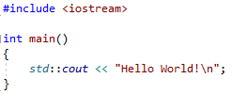
Hello world Program

Slide 4
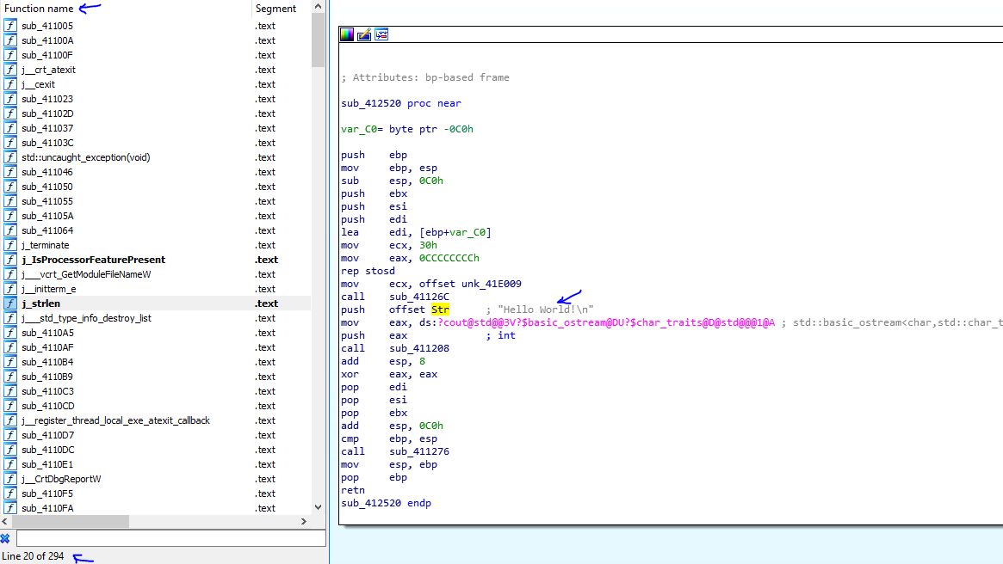
Hello world Program
contains:
294 library functions
1 function main()

Slide 5
</The Need>
When we decode those binary, we get the original assembly code which is running in the product
The need arises for easier and faster code analysis
We want to identify library functions more easily (in automatic process) without reading them

Slide 6
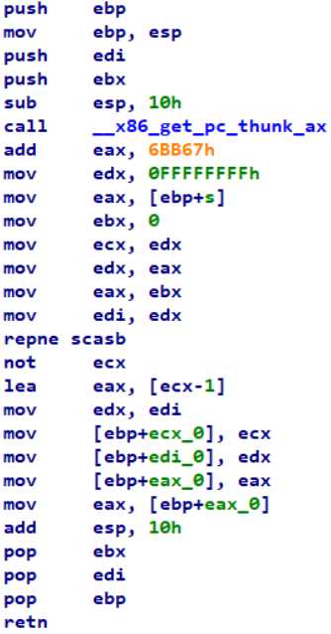
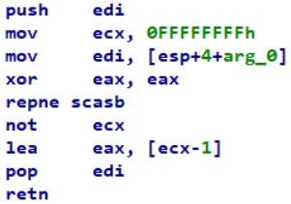
strlen function
Debug
Optimize

Slide 7
strlen function
Debug
Optimize

Slide 8
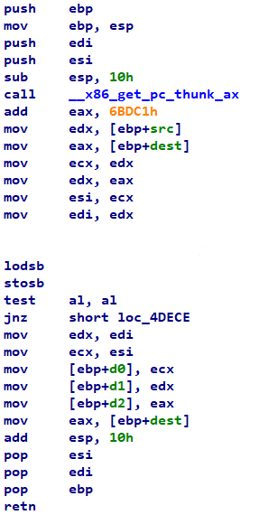
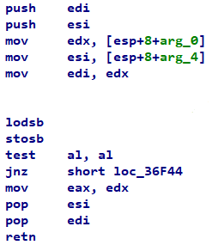
strcpy function
Debug
Optimize

Slide 9
strcpy function
Debug
Optimize

Slide 10


</My Thesis Question>
How to adjust between the assembly optimize function taken from the product and the assembly function is known to compile in a debug environment downloaded from open source repository independent architecture?

Slide 11
Purpose
How to match (static analysis) between the assembly function (optimize function) taken from the product and the assembly function is known to compile in a debug environment taken from the debug environment
I will answer this question regardless of the type of architecture

Slide 12
</Research>
Feasibility Study and Theory

Slide 13

</Research Approach>
We assume that there is a similarity between optimize and debug functions
We need to find features to comparison between two functions
Collect the features in a single formula
Solution optimization problem
Finding barriers (top and bottom) in favor of classification

Slide 14

</Similarity Features>
Mnemonic match
$$P\left(x\right)=\frac{\# of containment commands}{\# of command in release function}$$
Command rare match
$$P\left(x\right)=\frac{\# of times exist in debug }{\# of rare mnemonic commands mnemonic}$$
Constant match
$$P\left(x\right)=\frac{\# of times exist in debug }{\# of constants commands }$$
Nested function match
$$P\left(x\right)=\frac{\# of times exist in debug and release }{\# of call nested function in debug }$$
Jump match
$$P\left(x\right)=\frac{\#of jumps without condition in release function}{\#of jumps without condition in debug function}$$

Slide 15
strlen function
Debug
Optimize

Slide 16
strlen function
Debug
Optimize

Slide 17

How to Determine the Similarity ?
We will add weight parameters !

Slide 18
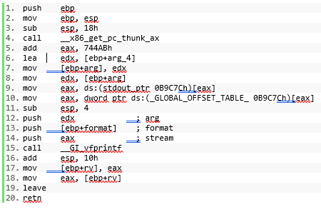
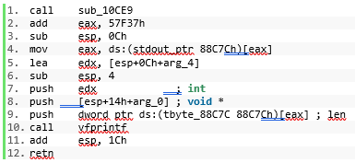
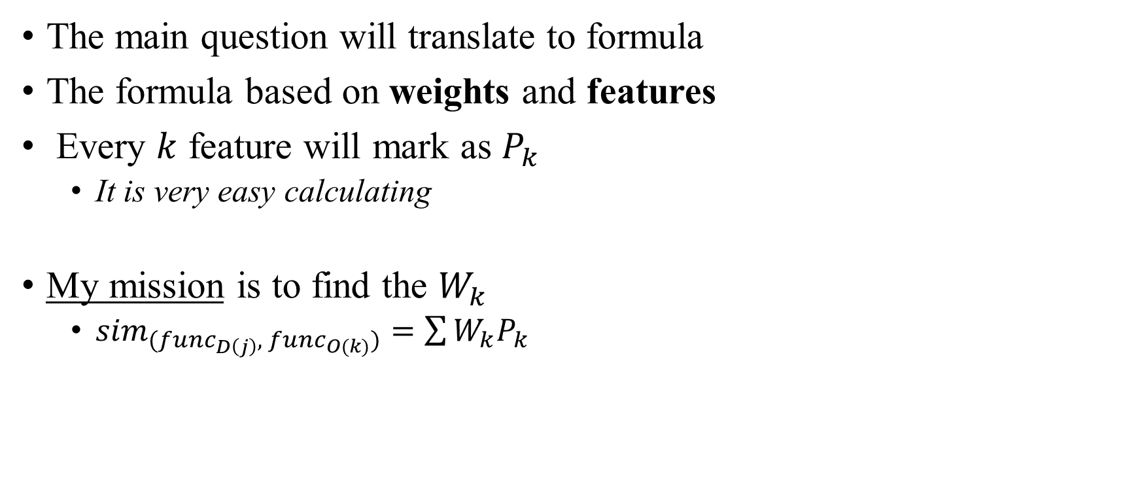


Weights - Definition
$${func}_{D\left(i\right)}$$
The main question will translate to formula
The formula based on weights and features
Every $k$ feature will mark as $P_{k}$
It is very easy calculating
My mission is to find the $W_{k}$
${sim}_{({func}_{D\left(j\right)},{ func}_{O(k)})}=\sum{W_{k}P_{k}}$
$${func}_{O\left(j\right)}$$

Slide 19

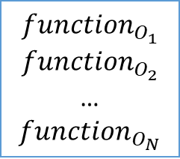
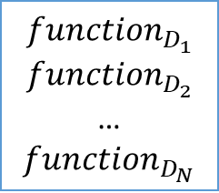


$${function}_{D_{1}}$$
$${function}_{D_{2}}$$
…
$${function}_{D_{N}}$$
$$Debug$$
$$Optimize$$
$${function}_{O_{1}}$$
$${function}_{O_{2}}$$
…
$${function}_{O_{N}}$$

Slide 20
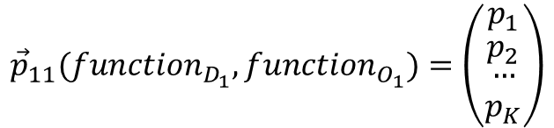
$${function}_{D_{1}}$$
$${function}_{D_{2}}$$
…
$${function}_{D_{N}}$$
$$Debug$$
$${\vec{p}}_{11}({function}_{D_{1}},{function}_{O_{1}})=\left(\begin{matrix}p_{1} \\ \begin{matrix}p_{2} \\ \begin{matrix}… \\ p_{K}\end{matrix}\end{matrix}\end{matrix}\right)$$
$$Optimize$$
$${function}_{O_{1}}$$
$${function}_{O_{2}}$$
…
$${function}_{O_{N}}$$

Slide 21
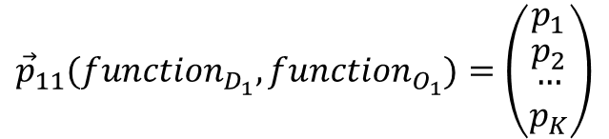

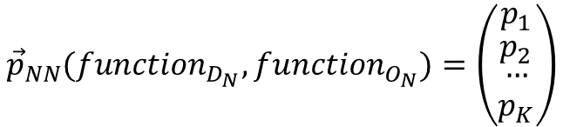
$${function}_{D_{1}}$$
$${function}_{D_{2}}$$
…
$${function}_{D_{N}}$$
$$Debug$$
$${\vec{p}}_{11}({function}_{D_{1}},{function}_{O_{1}})=\left(\begin{matrix}p_{1} \\ \begin{matrix}p_{2} \\ \begin{matrix}… \\ p_{K}\end{matrix}\end{matrix}\end{matrix}\right)$$
$$……$$
$${\vec{p}}_{NN}({function}_{D_{N}},{function}_{O_{N}})=\left(\begin{matrix}p_{1} \\ \begin{matrix}p_{2} \\ \begin{matrix}… \\ p_{K}\end{matrix}\end{matrix}\end{matrix}\right)$$
$$Optimize$$
$${function}_{O_{1}}$$
$${function}_{O_{2}}$$
…
$${function}_{O_{N}}$$

Slide 22
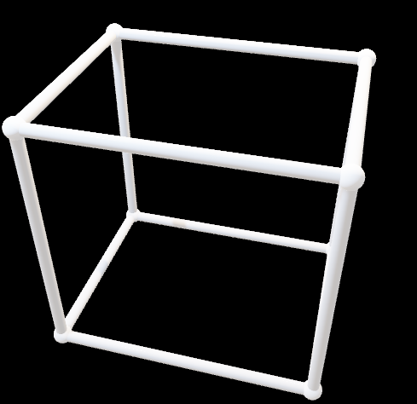
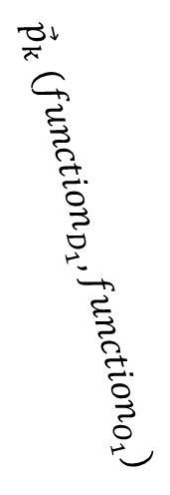




$${function}_{D_{i}}$$
$$Debug$$
$${function}_{O_{j}}$$
$$Optimize$$
$${\vec{p}}_{k} ({function}_{D_{1}},{function}_{O_{1}})$$

Slide 23

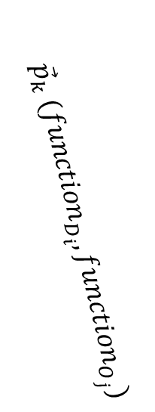

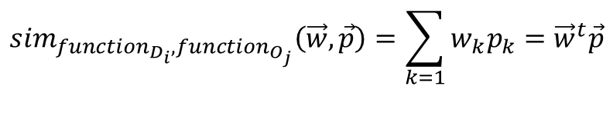
$${function}_{D_{i}}$$
$$Debug$$
$${function}_{O_{j}}$$
$$Optimize$$
$${\vec{p}}_{k} ({function}_{D_{i}},{function}_{O_{j}})$$
$$\dim{=3}$$
$$sim$$
$${sim}_{{function}_{D_{i}},{function}_{O_{j}}}\left(\vec{w},\vec{p}\right)=\sum_{k=1}{w_{k}p_{k}={\vec{w}}^{t}\vec{p}}$$

Slide 24


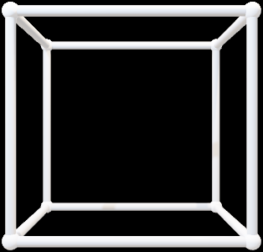


$$Symmetric Diagonally Dominant matrix(SDD)$$
$${function}_{D_{i}}$$
$${function}_{D_{i}}$$
$${function}_{O_{j}}$$
$$Debug$$
$${function}_{O_{j}}$$
$$Optimize$$
$${\vec{p}}_{k} ({function}_{D_{i}},{function}_{O_{j}})$$
$$\dim{=2}$$
$$\dim{=3}$$
$$sim$$
$$sim$$
$${sim}_{{function}_{D_{i}},{function}_{O_{j}}}\left(\vec{w},\vec{p}\right)=\sum_{k=1}{w_{k}p_{k}={\vec{w}}^{t}\vec{p}}$$

Slide 25
$$Symmetric Diagonally Dominant matrix(SDD)$$
$${function}_{D_{i}}$$
$${function}_{D_{i}}$$
$${function}_{O_{j}}$$
$$Debug$$
$${function}_{O_{j}}$$
$$Optimize$$
$${\vec{p}}_{k} ({function}_{D_{i}},{function}_{O_{j}})$$
$$\dim{=2}$$
$$\dim{=3}$$
$$sim$$
$$sim$$
$${sim}_{{function}_{D_{i}},{function}_{O_{j}}}\left(\vec{w},\vec{p}\right)=\sum_{k=1}{w_{k}p_{k}={\vec{w}}^{t}\vec{p}}$$

Slide 26

$$Diagonally Dominant matrix$$
$${function}_{D_{i}}$$
$${function}_{D_{i}}$$
$${function}_{O_{j}}$$
$$Debug$$
$${function}_{O_{j}}$$
$$Optimize$$
$${\vec{p}}_{k} ({function}_{D_{i}},{function}_{O_{j}})$$
$$\dim{=2}$$
$$\dim{=3}$$
$$sim$$
$$sim$$
$${sim}_{{function}_{D_{i}},{function}_{O_{j}}}\left(\vec{w},\vec{p}\right)=\sum_{k=1}{w_{k}p_{k}={\vec{w}}^{t}\vec{p}}$$

Slide 27
Why ?

Slide 28






$$Debug$$
$$strlen$$
$$Optimize$$
$$Debug$$
$$strcpy$$
$$Optimize$$

Slide 29
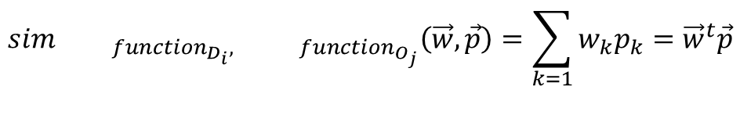
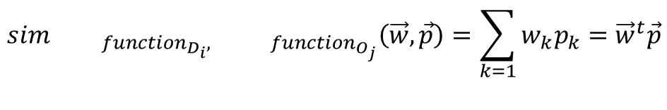
$$Debug$$
$${sim}_{{ function}_{D_{i}}, { function}_{O_{j}}}\left(\vec{w},\vec{p}\right)=\sum_{k=1}{w_{k}p_{k}={\vec{w}}^{t}\vec{p}}$$
$$strlen$$
$$Optimize$$
$$Debug$$
$${sim}_{{ function}_{D_{i}}, { function}_{O_{j}}}\left(\vec{w},\vec{p}\right)=\sum_{k=1}{w_{k}p_{k}={\vec{w}}^{t}\vec{p}}$$
$$strcpy$$
$$Optimize$$

Slide 30

Weights Optimization Problem
Every weight will be positive
$${0≤w}_{i}| 1≤i≤K$$
$$\sum_{i=1}{w_{i}}=1| 1≤i≤K$$
Every feature will be probabilistic value
$${0≤P}_{i}≤1$$

Slide 31
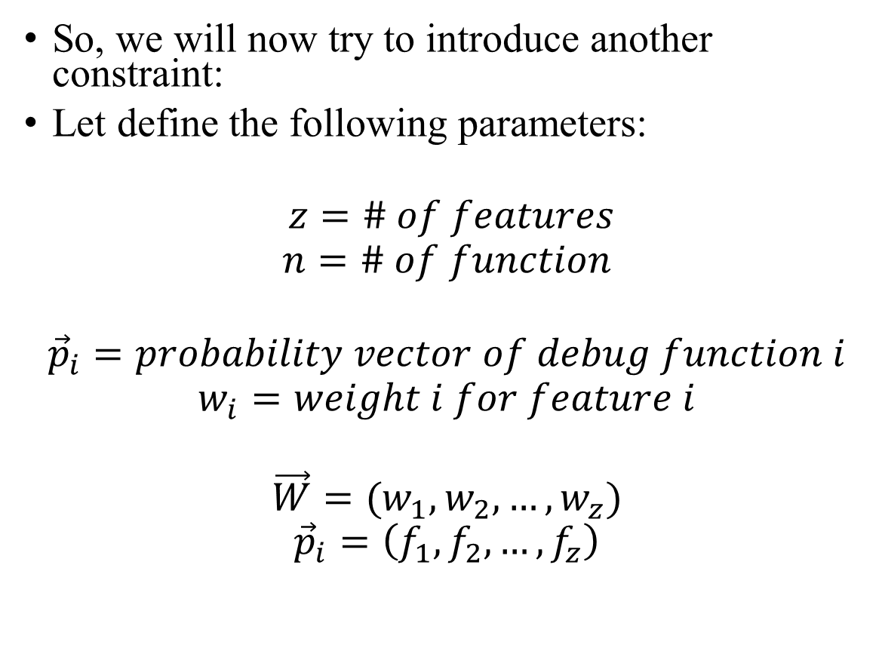
SDD DDM 𝐷𝑖𝑎𝑔𝑜𝑛𝑎𝑙𝑙𝑦 𝐷𝑜𝑚𝑖𝑛𝑎𝑛𝑡 Matrix
So, we will now try to introduce another constraint:
Let define the following parameters:
$$z=\# of features$$
$$n=\# of function$$
$${\vec{p}}_{i}=probability vector of debug function i$$
$$w_{i}=weight i for feature i$$
$$\vec{W}=(w_{1}, w_{2}, …, w_{z})$$
$${\vec{p}}_{i}=\left(f_{1}, f_{2}, …, f_{z}\right)$$

Slide 32
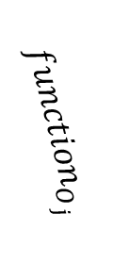

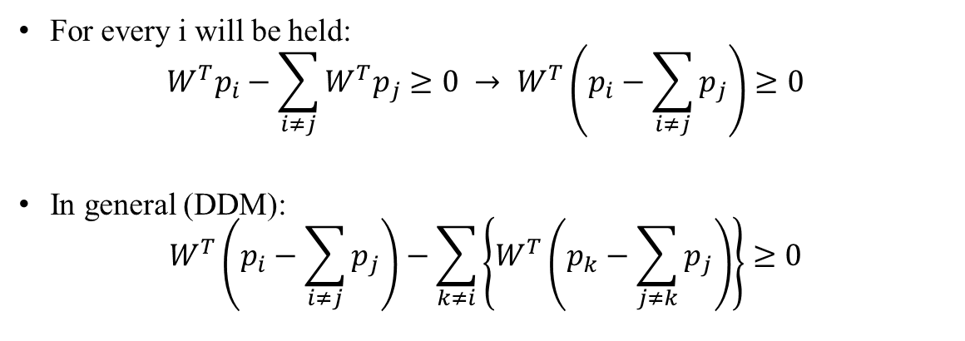
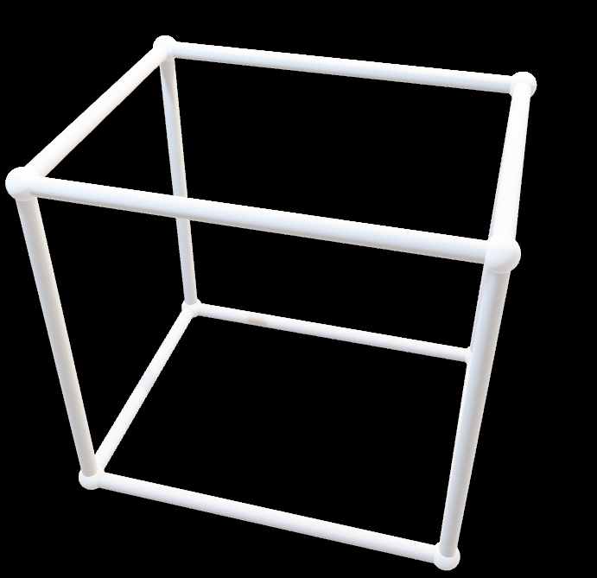
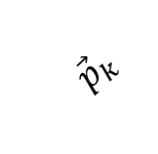
SDD DDM 𝐷𝑖𝑎𝑔𝑜𝑛𝑎𝑙𝑙𝑦 𝐷𝑜𝑚𝑖𝑛𝑎𝑛𝑡 Matrix
For every i will be held:
$$W^{T}p_{i}−\sum_{i≠j}{W^{T}p_{j}}≥0 → W^{T}\left(p_{i}−\sum_{i≠j}{p_{j}}\right)≥0$$
In general (DDM):
$$W^{T}\left(p_{i}−\sum_{i≠j}{p_{j}}\right)−\sum_{k≠i}{\left\{W^{T}\left(p_{k}−\sum_{j≠k}{p_{j}}\right)\right\}}≥0$$
$${\vec{p}}_{k}$$
$${function}_{D_{i}}$$
$${function}_{O_{j}}$$

Slide 33


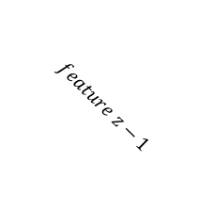
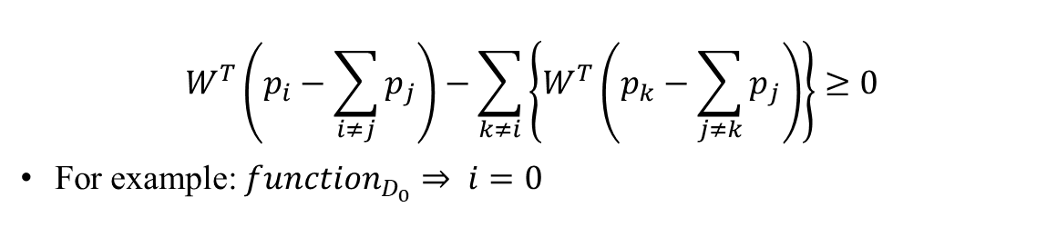
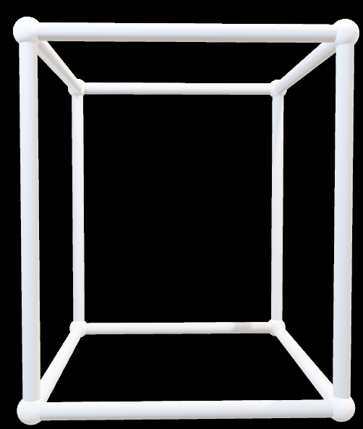
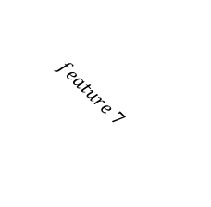


SDD DDM 𝐷𝑖𝑎𝑔𝑜𝑛𝑎𝑙𝑙𝑦 𝐷𝑜𝑚𝑖𝑛𝑎𝑛𝑡 Matrix
$$W^{T}\left(p_{i}−\sum_{i≠j}{p_{j}}\right)−\sum_{k≠i}{\left\{W^{T}\left(p_{k}−\sum_{j≠k}{p_{j}}\right)\right\}}≥0$$
For example: ${function}_{D_{0}}⇒ i=0$
$${\vec{p}}_{k}$$
$$feature z−1$$
$$feature 0$$
$$feature 7$$
$$feature 1$$
$${function}_{O_{j}}$$

Slide 34
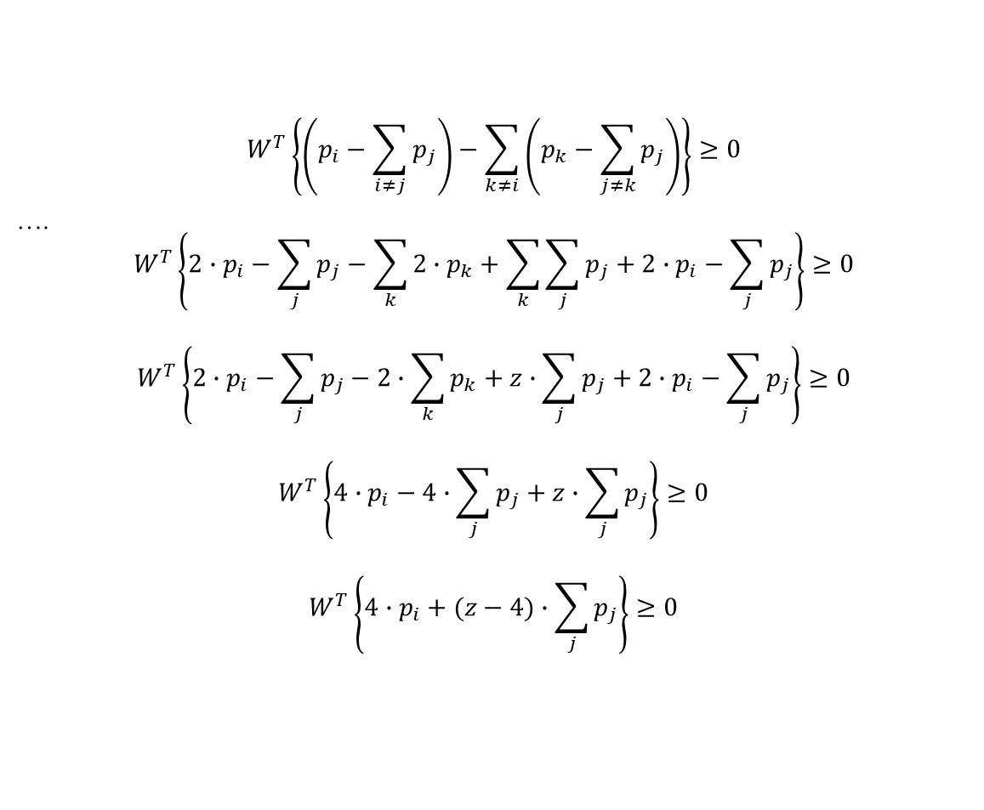
SDD DDM 𝐷𝑖𝑎𝑔𝑜𝑛𝑎𝑙𝑙𝑦 𝐷𝑜𝑚𝑖𝑛𝑎𝑛𝑡 Matrix
$$W^{T}\left\{\left(p_{i}−\sum_{i≠j}{p_{j}}\right)−\sum_{k≠i}{\left(p_{k}−\sum_{j≠k}{p_{j}}\right)}\right\}≥0$$
….
$$W^{T}\left\{2∙p_{i}−\sum_{j}{p_{j}}−\sum_{k}{2∙p_{k}+\sum_{k}{\sum_{j}{p_{j}}}}+2∙p_{i}−\sum_{j}{p_{j}}\right\}≥0$$
$$W^{T}\left\{2∙p_{i}−\sum_{j}{p_{j}}−2∙\sum_{k}{p_{k}}+z∙\sum_{j}{p_{j}}+2∙p_{i}−\sum_{j}{p_{j}}\right\}≥0$$
$$W^{T}\left\{4∙p_{i}−4∙\sum_{j}{p_{j}}+z∙\sum_{j}{p_{j}}\right\}≥0$$
$$W^{T}\left\{4∙p_{i}+(z−4)∙\sum_{j}{p_{j}}\right\}≥0$$

Slide 35

Define Optimization Problem
Define again:
$$4∙p_{i}+(z−4)∙\sum_{j}{p_{j}}≜v_{i}$$
And,
$${\vec{w}}^{t}v_{i}≥0 | 1≤i≤N$$
So,
$$\vec{V}=\left\{v_{1},v_{2}, …,v_{N}\right\}⇒{\vec{w}}^{t}\vec{V}$$
And finally:
$$max C$$
Such that
$${\vec{w}}^{t}\vec{V}−C≥0$$

Slide 36
</Prototype>
MATLAB Implementation and Verification

Slide 37
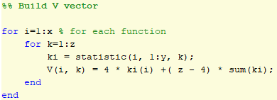
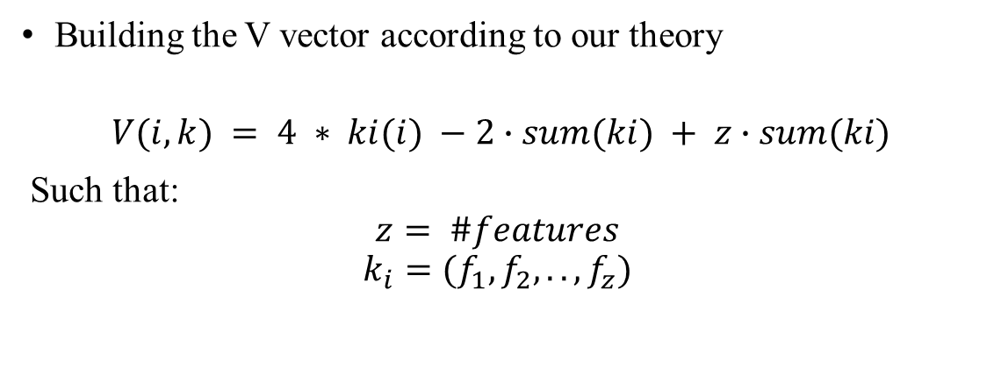
Matlab Initialization
Building the V vector according to our theory
$$V(i, k) = 4 ∗ ki(i) −2∙sum(ki) + z∙sum(ki)$$
Such that:
$$z= \#features$$
$$k_{i}=(f_{1}, f_{2}, .., f_{z})$$

Slide 38
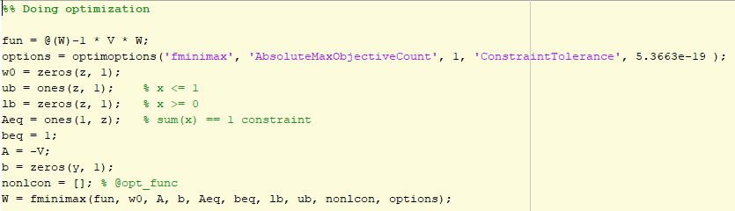
Matlab - Optimization
Mathematical problem definition. Since MATLAB restricts the use of its functions in noisy functions in the fminimax optimization function and we also translated our maxmin problem into the minmax of MATLAB and the code below:

Slide 39
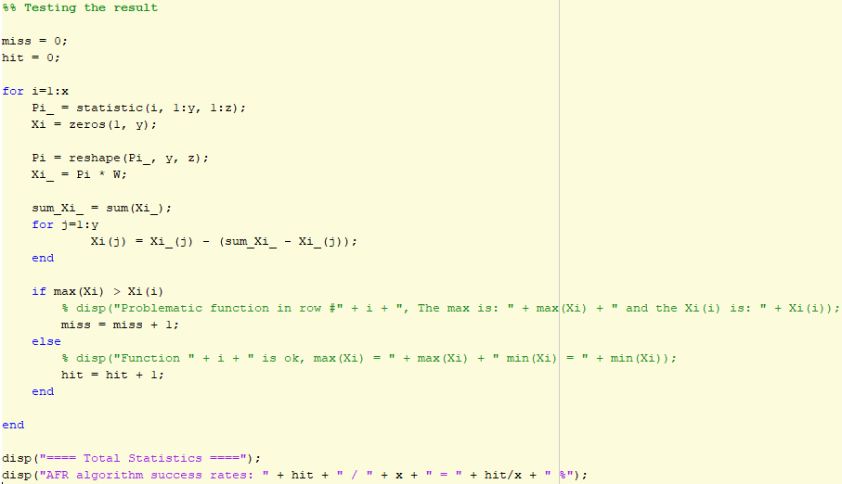
Matlab - Validation
Testing the result. Calculating the grade of similarity for each pairs function i and j and check if results equal to real data (needed to get Diagonally Dominant matrix)

Slide 40
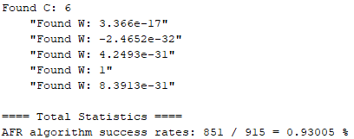
Results
Here are the results of running the code:

Slide 41
</Conclusion>
Ideas for further research

Slide 42

Conclusion - Ideas
This thesis leaves several investigations. The following list detail couple of them:
This model found a solution for functions contain over k assemblies commands (statistics results based on k = 10). There is another difficulty in identifying functions that contain a small number of commands and so some questions are asked such as what is the minimum k that this model solves? Is it possible to add a feature that solves the lack of information problem in small functions (such as dividing into equivalent groups of k commands) instead of solving the lower block problem ?
It will be interesting to investigate the DNA (C and $\vec{W}$) of additional library functions with the same features, this study will yield C and weight values that will be interesting to see the similarities (if exist) and their differences in construction
A study of adding new features to assembly code will only improve the model for better results and accuracy

Slide 43


AFR Thank You ! https://github.com/MatanAvitan100/AFR matanavtian100@gmail.com
Mr. Matan Avitan
Prof. Zeev (Vladimir) Volkovich
May 2019

